Slide 1


HRAlways
Meant to Deliver Quality Always

Slide 2





ABOUT US
HRAlways delivers creative and strategic recruitment solutions across multiple industries, striving to provide exceptional service and attention to detail. When you work with HRAlways, you’ll experience a one-on-one focus on all your staffing needs.
500
Job Posted
150
Current Listings
We treat our clients as partners, and their objectives become ours. Our mature processes, development approach, and “can-do” attitude help us drive the process to co-production. Therefore, we provide several engagement options to align with your needs depending on the future project complexity and the available budget.
666
Matches Made

Slide 3




OUR PHILOSOPHY
OUR VISI^{T}O^{itle O}N^{ne}
As a recruitment agency, we place a strong emphasis on the development of the talents that make your company up. This is why we place recruitment at the heart of our competitiveness and performance.
OUR MISS^{Tit}I^{le}O^{One}N
We provide a personal service to each and every one of our clients, that adapt their needs. We help organizations accelerate their growth, by providing the best human resource strategies and solutions available.
OUR BUSIN^{Title}E^{On}S^{e} S
Putting our sectoral and HR expertise at the service of our clients to meet their human resources needs.

Slide 4
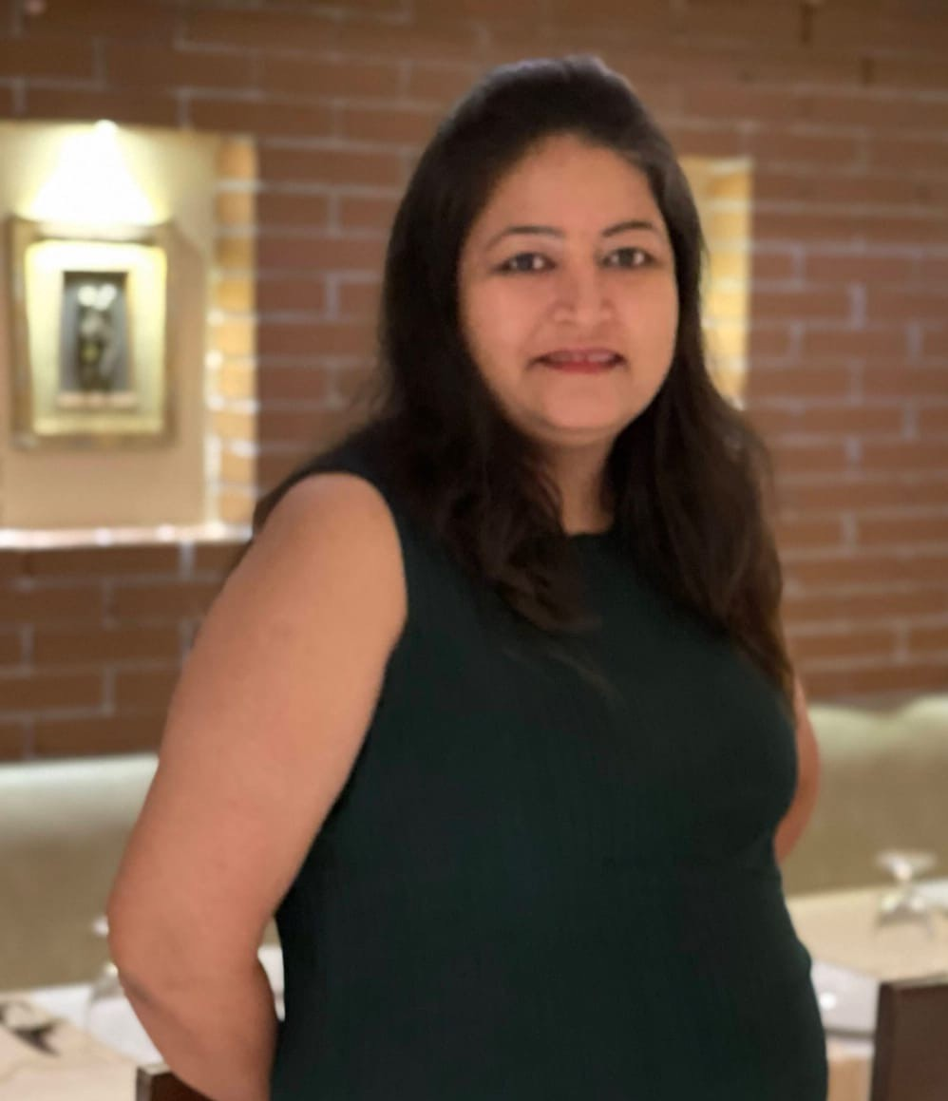
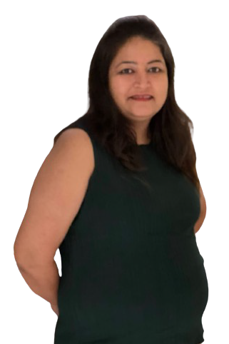













Our Founder
She is an aggressive and successful entrepreneur with 16 years of work experience. She has an MBA in HR from NMIMS and has successfully managed the operations of HRAlways. She has been serving as the face of HRAlways for the past 13 years and has a human perspective when it comes to dealing with the leadership team and understanding manpower problems.
Team Dynamics
20 Researchers conduct study on requirements, skills, etc. and reports to Junior Recruiters
Initiates communication with prospects and reports to Senior Recruiter with their requirements
Senior Recruiters analyze and select the best candidates and report to Founder to finalize

Slide 5


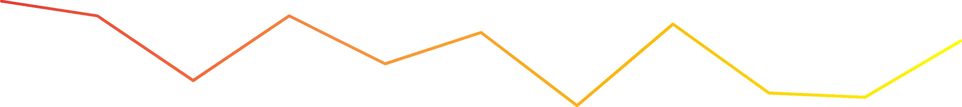














IT RECRUITMENT TEAM: COMPETENCY GRAPH
92%
85%
85%
81%
77%
73%
62%
54%
48%
46%
42%
Web Technologies
Mobile Technologies
Infrastructure
ERP
DBA & Security
Testing & QA
Cloud Tech
Design
Data Science
Embedded Tech
Project Mgmt
TEAM CAPABILITY
We are a team of 30+ professionals, with range experience from 4 years to 10 years in Recruitment. Our team has focused on delivering excellent service to our clients and recruiting candidates that they need. We are successfully employed 1,000+ candidates across 25+ clients and are servicing more than 5 sectors

Slide 6




SECTORS AND ROLES WHERE WE HAVE SUCCESSFULLY HIRED
IT - DEVELOPMENT
MANUFACTURING
Food and Beverage, Agritech, Automobile , Electronics Equipment, Clothing and Textile, Paper and Wood, Leather, transportation equipment manufacturing, Metal, Petroleum, Chemicals, and Plastics
NET developer, AI Developer, Analytics, Android Developer, App Developer, App Development, Automated Software Developer/Engineer, Business Analyst, Cloud Developer, DevOps Specialist, Embedded Software Engineer,
Front End Developer, Full Stack Developer, Games Developer/Designer, Games Development, IOS Developer, Hardware Engineer, Implementation Analyst, Infrastructure Engineer, IT Manager, IT Security Engineer, Java Developer, Linux, Machine Learning, Machine Learning Specialist, Migration Support Specialist, Network Administrator, Network Engineer, PHP Developer, Programmer, SQL/Database Engineer, Software Developer, Software Engineer, Retail, Servers, Software, Software Architect, Ubuntu, UI Designer/Developer, UNIX Engineer, UX Designer/Developer, Web Designer/Developer, Web Development
BUSINESS SUPPORT FUNCTION
Finance and procurement; Human Resources; Infrastructure management; Information Services; Communications and marketing.
LEADERSHIP ROLE
Chief Financial Officer (CFO), Chief Information Officer (CIO), Chief Operating Officer (COO), Vice President, and President. include: Human Resources Manager Organization Manager

Slide 7


















CURRENT CLIENTS
UPCOMING CLIENTS

Slide 8









By combining years of industry experience and market insight, we help you find the ideal leaders for your organisation.
LEADERSHIP HIRING
OUR SERVICES
MANAGERIAL HIRING
We are dedicated to helping you hire the most talented managers to help your team members develop their skills and reach their goals.
NICHE HIRING
We search for the best fit candidate with the relevant skills and experience that is tailored to meet your business requirements.

Slide 9








Multi Channel Sourcing Model
PARTNER NETWORK
Network of 100+ sourcing partners, Training institutes, Assessment platforms etc for IT
EMPLOYEE REFERRAL
10,000+ Strong Service Employees network for Employee Referral
JOB FAIRS
Weekly Job Fairs for attracting active jobseekers, immediate joiners
EXECUTIVE SEARCH
Focused Headhunting for Niche and High-Range Executives
AI-BASED INTERNAL DATABASE SEARCH
16 Lakh Profiles on Internal Database, filtered via Auto-Screening
BENCH DEPLOYMENT/ VIRTUAL POOL
Readily available resources on our bench and also with our partners
CONTINUOUS MARKETING
60k+ candidates added monthly from Marketing campaigns run for Priority requirements
COLLEGE NETWORK
Network with colleges in major cities to help with their placement needs

Slide 10





















OUR RECRUITMENT PROCESS
Discuss your recruiting needs and set a strategy
Develop job descriptions
Post your positions to major recruitment websites
Narrow down potential candidates with in-depth screening
Conduct skills testing and
pre-employment assessments
Perform real-time market and compensation analyses
Quickly deliver a qualified talent pool
Coordinate and schedule interviews
Negotiate the employment offer
Fill your positions the right way, the first time

Slide 11













Why HRAlways ?
At HRAlways, we believe that the key to a successful business is a strong and effective team. That's why we offer our three core services: Managerial Hiring, Niche Hiring, and Leadership Hiring. Our experienced consultants offer unparalleled assistance every step of the way, from finding the best talent to ensuring your leadership team is as effective as possible
Wide Reach
Depth of Experience
Consistency of Service
Industry Specialists
Top Sourcing Strategies

Slide 12





Partner With Us Today
Mobile- +91 8652 351 111
HRAlways
Meant to Deliver Quality Always
Email- anushka@hralways.in
Website- www.hralways.in

